Slide 1




PREDICTION OF CYBER ATTACKS USING MACHINE LEARNING TECHNIQUES
A Thesis Presentation Submitted in Partial Fulfillment of the Requirements for the Degree of Bachelor of Computer Applications (BCA)
Department of BCA
Yuvodaya College of Advanced Technology,
Sakma, Balangir
Presented By:- - Rohan Kumar Tripathy
R05423BCA029 &
- Ayush Das
R05423BCA009
Under the Guidance of:
Dr. Jagamohan Padhi
Principal, YCAT
Academic Year: 2023–2026

Slide 2

INTRODUCTION
CYBER ATTACK
Rapid growth of Internet
-> Increase in Cyber Threats
Traditional security system are reactive
Need for Proactive Attack Prediction System
Data Science helps analyze patterns in Network Traffic

Slide 3
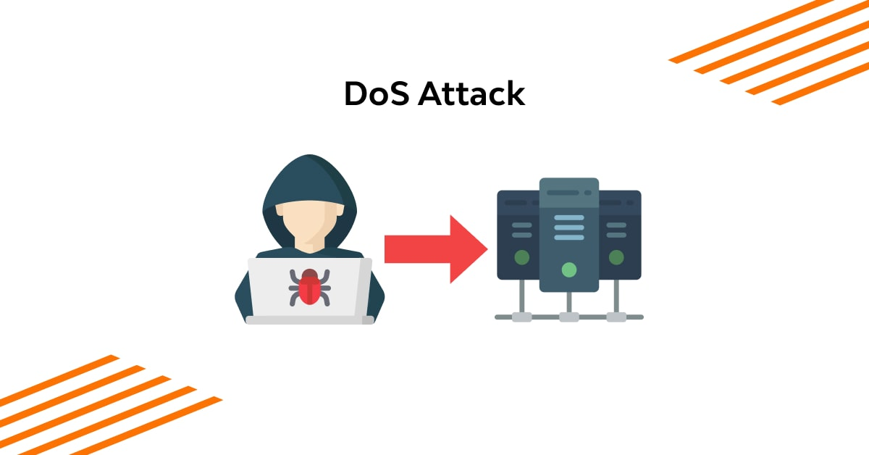



TYPES OF CYBER ATTACKS
DoS (Denial of Service) – overload system
R2L (Remote to Local) – remote access
U2R (User to Root) – privilege escalation
Probe Attack – scanning vulnerabilities

Slide 4
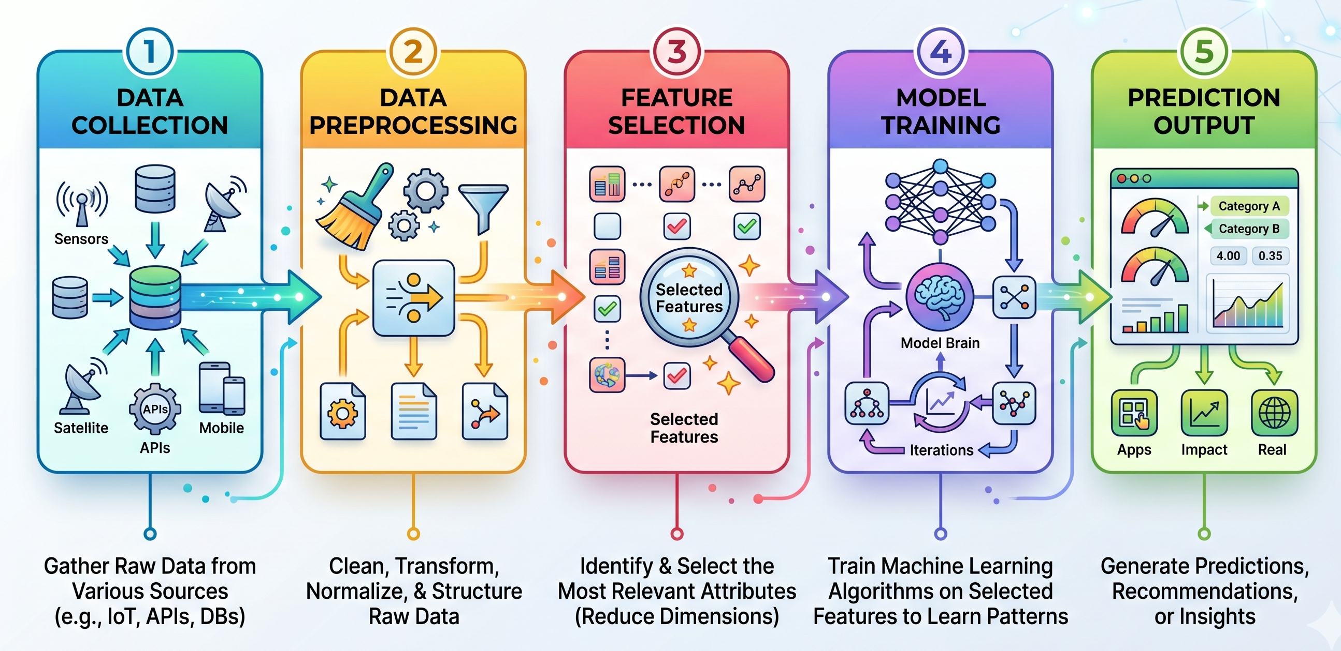
SYSTEM ARCHITECTURE

Slide 5
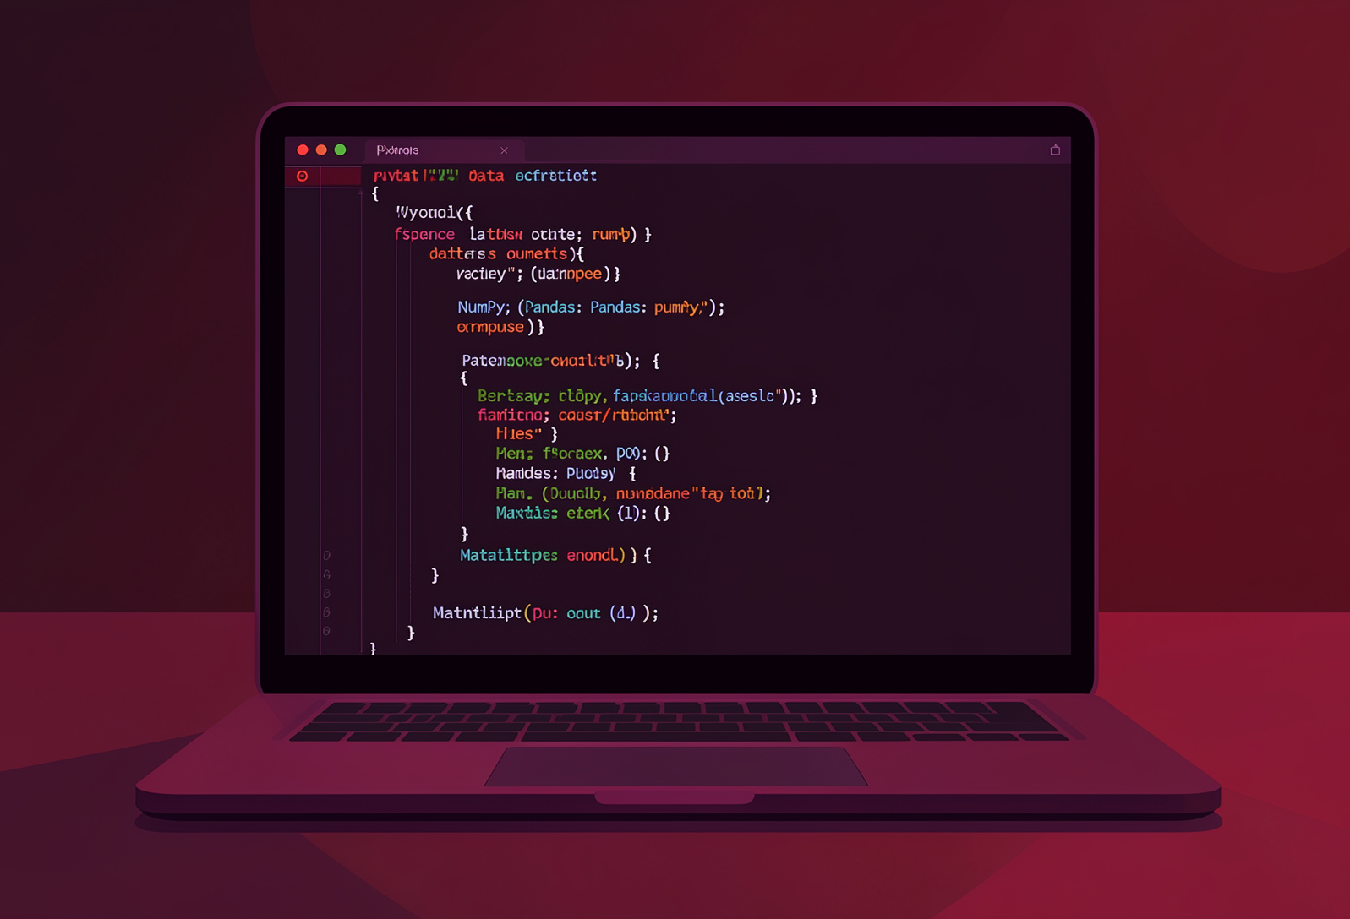
TOOLS AND TECHNOLOGIES USED
Programming Language - Python
Chosen for its rich ecosystem of ML and data analysis libraries.
Core Libraries
NumPy & Pandas: Data manipulation and numerical computation
Scikit-learn: Model implementation, training, and evaluation
Matplotlib: Visualization and EDA plotting
Development Platform
Anaconda distribution with Jupyter Notebook for interactive experimentation and reproducible research.

